Slide 1

START POSITION: Standing anywhere in the shooting area, facing downrange. Handgun, wrists below belt. PCC, buttstock on belt, weak hand wrist below the belt.
STAGE PROCEDURE: Upon start signal, engage targets as they become visible from within the shooting area A,B, or C |  | SCORING: Comstock, 26 rounds, 130 points TARGETS: 13 USPSA SCORED HITS: Best 2 per paper START-STOP: Audible - Last shot RULES: USPSA current edition
Near & Far
26 Rounds v10
Designed for CGC bays 2, 3 or 4
T1
T 6,7,8
T13
Back of Range
T 2,3
T 4,5
T 9,10
T 11,12
3 Yards
7 Yards
C
15 Yards
Notes: T 1,2,3 only visible from A T4,5,9,10 only visible sides of C T6,7,8 only visible through port but not side of C
T 11,12,13 only visible from B
A
B

Slide 2
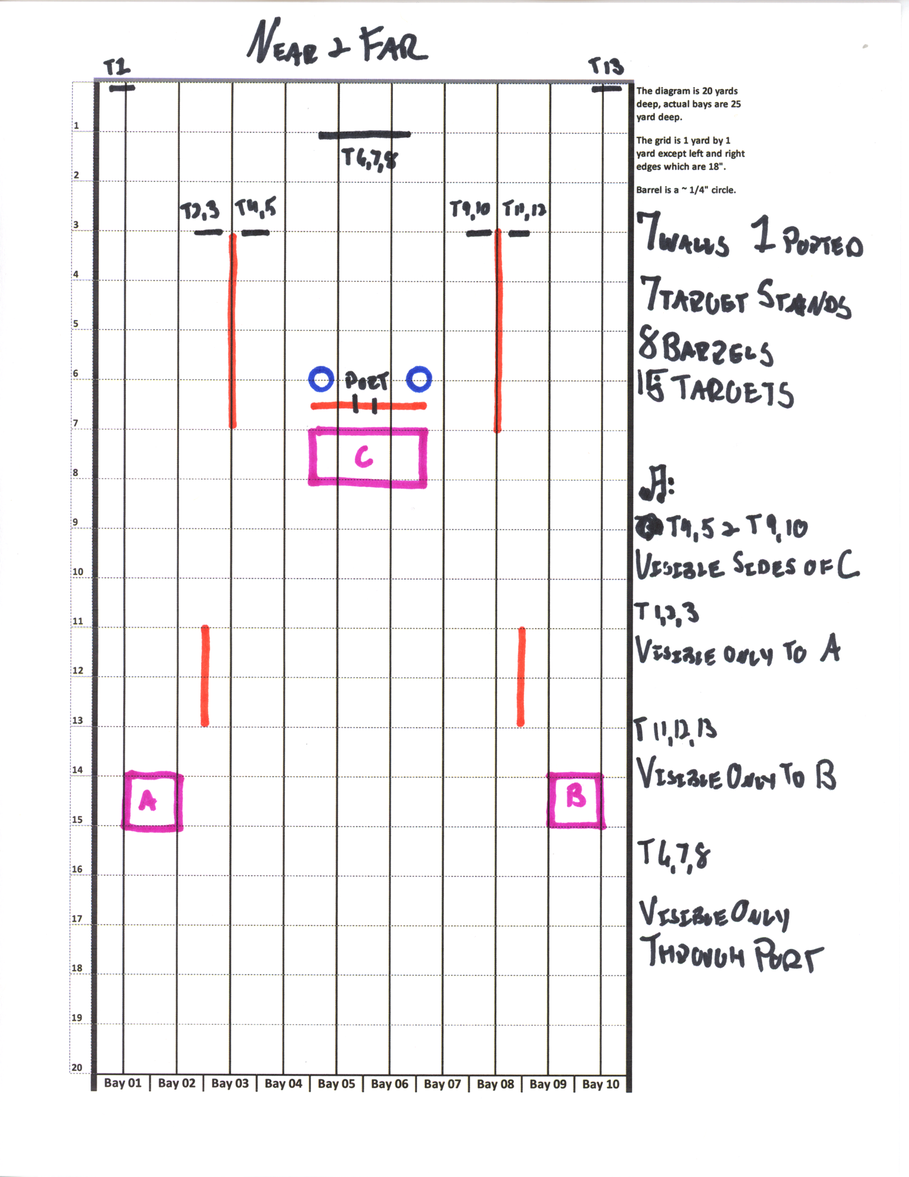
26 Rounds v10-Near&Far

